Slide 1
MEASURES OF DISPERSION

Slide 2
The measures of central tendency describe that the major part of values in the data set appears to concentrate ( or cluster) around a central value called average with the remaining values scattered (spread or distributed) on either sides of that value.
But these measures do not reveal how these values are dispersed (spread or scatter) on each side of the central value.

Slide 3
THE STATISTICAL TECHNIQUES TO MEASURE SUCH DISPERSION ARE OF TWO TYPES
Techniques that are used to measure the extent of variation or the deviation (also called degree of variation) of each value in the data set from a measure of central tendency usually the mean or median. Such statistical techniques are called measures of dispersion (or variation).
To measure the dispersion, understanding it, and identifying its causes is very important in statistical inference.
Conversely, a large dispersion among values in the data set indicates that the mean is not reliable, i.e. it is not representative of the data.

Slide 4
SIGNIFICANCE OF MEASURING DISPERSION (VARIATION)
Test the reliability of an average:
Measures of variation are used to test to what extent an average represents the characteristic of a data set.
If the variation is small, that is, extent of dispersion or scatter is less on each side of an average, then it indicates high uniformity of values in the distribution and the average represents an individual value in the data set.
On the other hand, if the variation is large, then it indicates a lower degree of uniformity in values in the data set, and the average may be unreliable. No variation indicates perfect uniformity and, therefore, values in the data set are identical.

Slide 5
Control the variability
Measuring of variation helps to identify the nature and causes of variation. Such information is useful in controlling the variations.
Compare two or more sets of data with respect to their variability
Measures of variation help in the comparison of the spread in two or more sets of data with respect to their uniformity or consistency.
For example,
the measurement of variation in share prices and their comparison with respect to different companies over a period of time requires the measurement of variation

Slide 6
4. Facilitate the use of other statistical techniques: Measures of variation facilitate the use of other statistical techniques such as correlation and regression analysis, hypothesis testing, forecasting, quality control, and so on.

Slide 7
CLASSIFICATION OF MEASURES OF DISPERSION
The various measures of dispersion (variation) can be classified into two categories:
1. Absolute measures, and
2. Relative measures
Absolute measures are described by a number or value to represent the amount of variation or differences among values in a data set.
Such a number or value is expressed in the same unit of measurement as the set of values in the data such as rupees, inches, feet, kilograms, or tonnes.

Slide 8
The relative measures are described as the ratio of a measure of absolute variation to an average and is termed as coefficient of variation.
The word ‘coefficient’ means a number that is independent of any unit of measurement.
Example: 6z means 6 times z, and "z" is a variable, so 6 is a coefficient.
What is coefficient example?
A coefficient is an integer that is written along with a variable
In other words, a coefficient is the numerical factor of a term containing constant and variables.
For example, in the term 2 x, 2 is the coefficient.

Slide 9
Another classification of the measures of variation is based on the method employed for their calculations:
1. Distance measures
2. Average deviation measures
The distance measures describe the spread or dispersion of values of a variable in the data set.
The average deviation measures describe the average deviation for a given measure of central tendency.

Slide 10
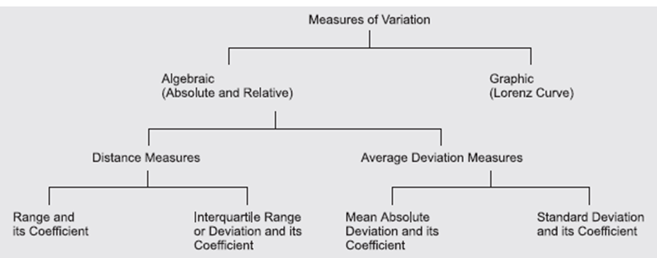

Slide 11
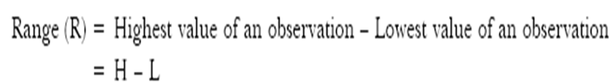

Range
The range is the most simple measure of dispersion and is based on the location of the largest and the smallest values in the data. Thus the range is defined to be the difference between the largest and lowest observed values in a data set.
Coefficient of Range
The relative measure of range, called the coefficient of range is obtained by applying the following formula:

Slide 12


EX. The following are the sales figures of a firm for the last 12 months
Calculate the range and coefficient of range for sales.
Solution: Given that H = 92 and L = 80. Therefore

Slide 13
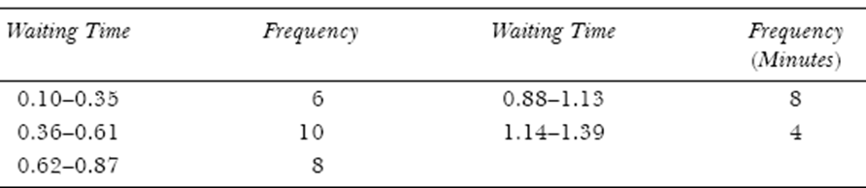
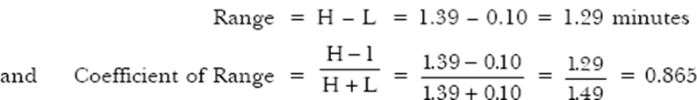
The following data show the waiting time of telephone calls. Calculate the range and coefficient of range.

Slide 14
Advantages, Disadvantages and Applications of Range The major advantages and disadvantages of range may be summarized as follows:
Advantages
It is independent of the measure of central tendency and easy to calculate and understand.
2. It is quite useful in cases where the purpose is only to find out the extent of extreme variation, such as industrial quality control, temperature, rainfall, and so on.

Slide 15
Disadvantages
The calculation of range is based on only two values—largest and smallest in the data set and fail to take account of any other observations.
It is largely influenced by two extreme values and completely independent of the other values.
Its value is sensitive to changes in sampling, that is, different samples of the same size from the same population may have widely different ranges.
It cannot be computed in case of open-end frequency distributions because no highest or lowest value exists in open-ended class.
It does not describe the variation among values in the data between two extremes. For example, each of the following set of data has a range of 21 – 9 = 12, but the variation of values is quite different in each case between the hightest and lowest values.

Slide 16
Applications of Range
1. Fluctuation in share prices: The range is useful in the study of small variations among values in a data set, such as variation in share prices and other commodities that are very sensitive to price changes from one period to another.
2. Quality control: It is widely used in industrial quality control. Quality control is exercised by preparing suitable control charts. These charts are based on setting an upper control limit (range) and a lower control limit (range) within which produced items shall be accepted. The variation in the quality beyond these ranges requires necessary correction in the production process or system.
3. Weather forecasts: The concept of range is used to determine the difference between maximum and minimum temperature or rainfall by meteorological departments to announce for the knowledge of the general public.

Slide 17
Interquartile Range or Deviation
To compute this value, the entire data set is divided into four parts each of which contains 25 per cent of the observed values.
The quartiles are the highest values in each of these four parts.
Quartiles are the measures of central tendency that divide a group of data into four sub-groups.
The interquartile range is a measure of dispersion or spread of values in the data set between the third quartile, Q3 and the first quartile, Q1

Slide 18
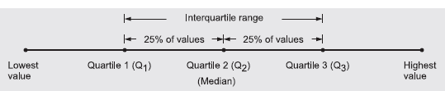
In other words, the interquartile range or deviation (IQR) is the range for the middle 50 per cent of the data. The concept of IQR is shown in

Slide 19


Interquartile range: A measure of variability, defined to be the difference between the quartiles Q₃and Q₁.
Half the distance between Q₁ and Q₃ is called the semi-inter quartile range or the quartile deviation(QD).

Slide 20
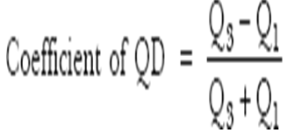
Coefficient of Quartile Deviation
Since quartile deviation is an absolute measure of variation, therefore its value gets affected by the size and number of observed values in the data set. Thus, the Q.D. of two or more than two sets of data may differ. Due to this reason, to compare the degree of variation in different sets of data, we compute the relative measure corresponding to Q.D., called the coefficient of Q.D., and it is calculated as follows:

Slide 21

Individual series Quartile deviation
Following are the responses from 55 students to the question about how much money they spent every day.
Calculate the range and interquartile range and interpret your result.
NOTE: SEE THAT THEY ARE IN ASCENDING ORDER

Slide 22

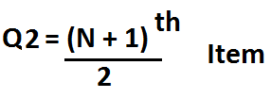

Slide 23
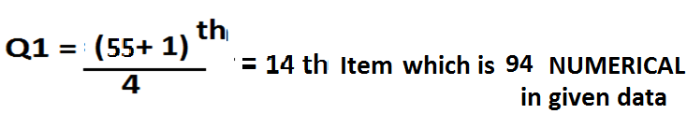
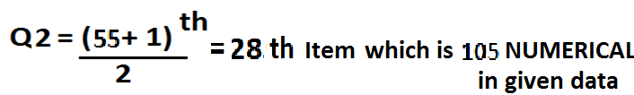
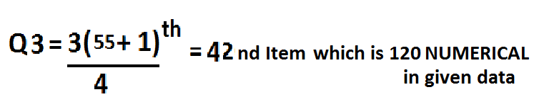
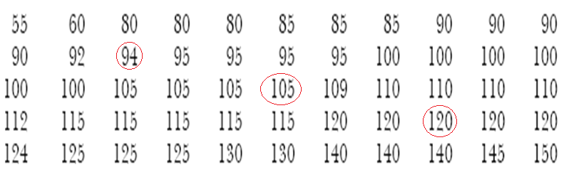

Slide 24

The interquartile range is, IQR = 120 – 94 = 26
while the range is R = 150 - 55 = 95.
For instance, lowest 25% of the students had responses, ranging over 55 to 94, i.e. Rs 39, 94 – 55 = 39
while the next 25% had responses ranging over 94 to 105, i.e. only Rs 11. 105 – 94 = 11
Similarly, the third quarter had responses from 105 to 120, i.e. only Rs 5, 120 – 105 = 15
while the top 25% had responses in the interval (120 to 150), i.e. Rs 30. 150-120 = 30
The median and quartiles divide the data into equal numbers of values

Slide 25


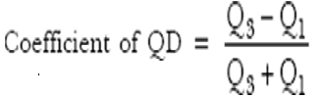


Slide 26
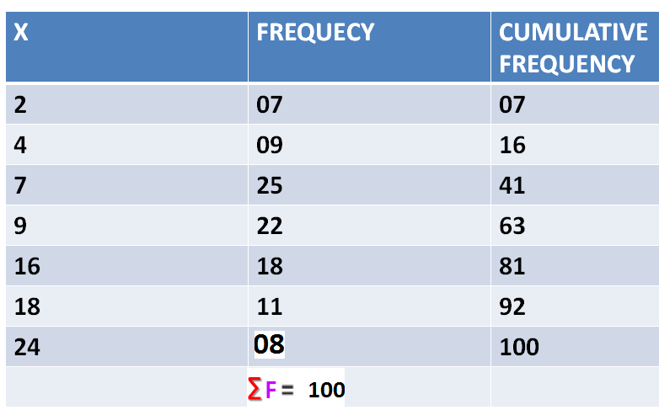
DISCRETE SERIES QD

Slide 27
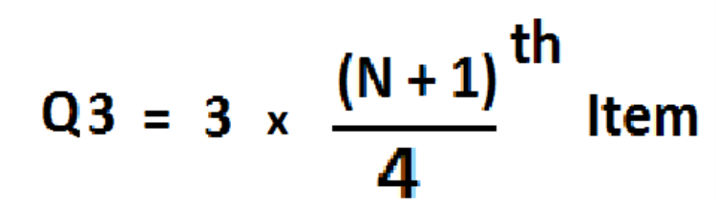

Slide 28
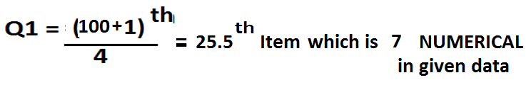
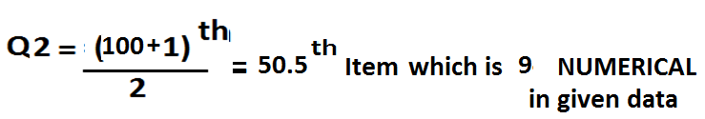
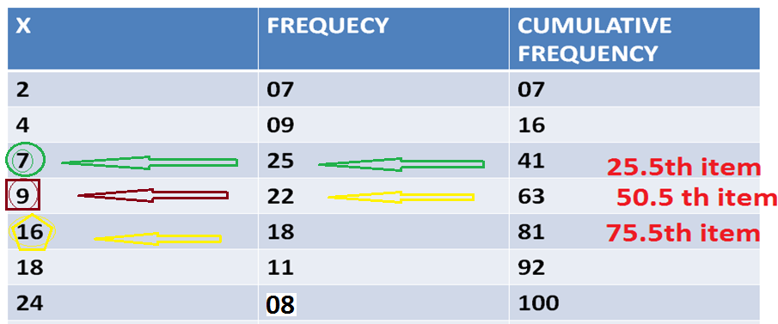

Slide 30
DISCRETE SERIES QD

Slide 31
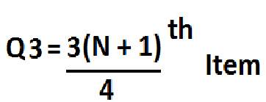

Slide 32
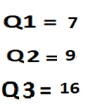

Slide 33
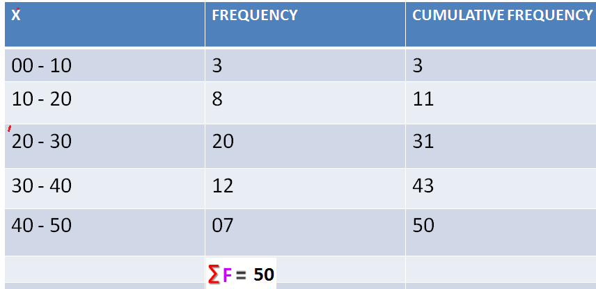
CONTINUOUS SERIES QD

Slide 34
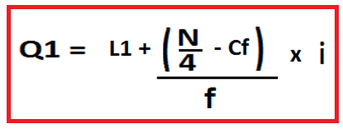

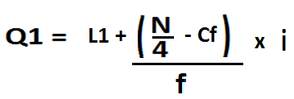

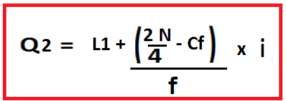

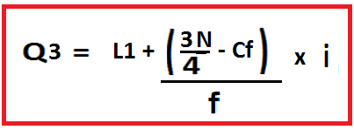


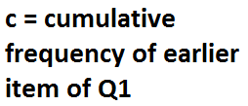


Slide 35
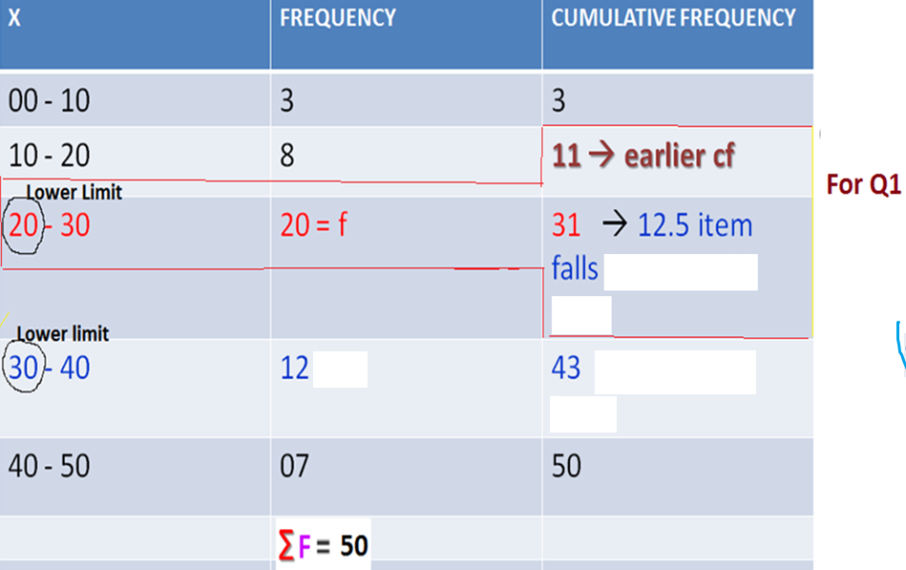

Slide 36



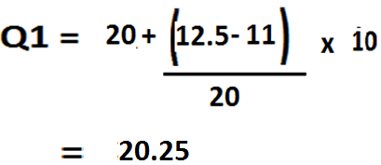

Slide 37
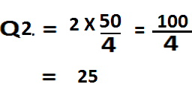



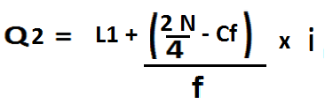
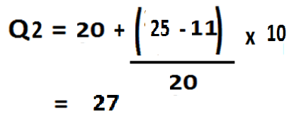

Slide 38
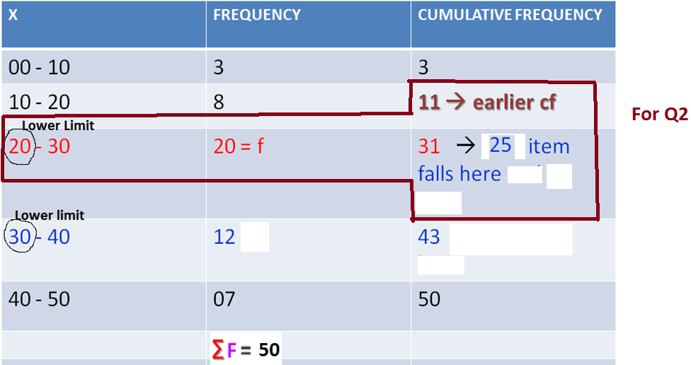

Slide 39
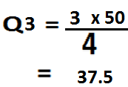


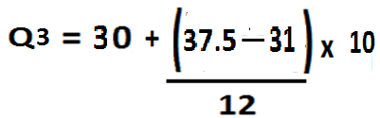
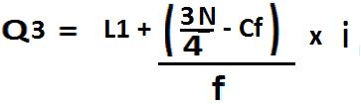


Slide 40
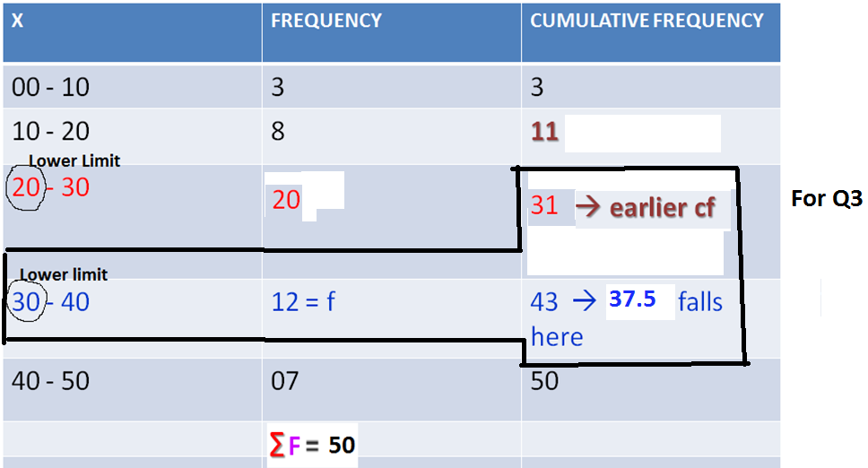

Slide 41
Advantages
It is not difficult to calculate but can only be used to evaluate variation among observed values within the middle of the data set. Its value is not affected by the extreme (highest and lowest) values in the data set.
It is an appropriate measure of variation for a data set summarized in open-end class intervals.
Since it is a positional measure of variation, therefore it is useful in case of erratic or highly skewed distributions, where other measures of variation get affected by extreme values in the data set.
Disadvantages
The value of Q.D. is based on the middle 50 per cent observed values in the data set, therefore it cannot be considered as a good measure of variation as it is not based on all the observations.
The value of Q.D. is very much affected by sampling fluctuations.
The Q.D. has no relationship to any particular value or an average in the data set for measuring the variation. Its value is not affected by the distribution of the individual values within the interval of the middle 50 per cent observed values.

Slide 42
AVERAGE DEVIATION MEASURES
The range and quartile deviation indicate overall variation in a data set, but do not indicate spread or scatteredness around the centre (i.e. mean, median or mode).
However, to understand the nature of distribution of values in the data set, we need to measure the ‘spread’ of values around the mean to indicate how representative the mean is.
Therefore the DEVIATION MEASURES used are:
Mean Absolute Deviation or Average Deviation
Variance and Standard Deviation

Slide 43
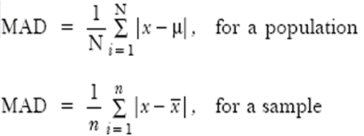
Mean Absolute Deviation
Since two measures of variation, range and quartile deviation, do not show how values in a data set are scattered about a central value or disperse themselves throughout the range, therefore it is quite reasonable to measure the variation as a degree (amount) to which values within a data set deviate from either mean or median.
The mean of deviations of individual values in the data set from their actual mean is always zero so such a measure (zero) would be useless as an indicator of variation. This problem can be solved in two ways:
1.Ignore the signs of the deviations by taking their absolute value, or
2.Square the deviations because the square of a negative number is positive.
where | | indicates the absolute value. That is, the signs of deviations from the mean are disregarded.

Slide 44
MEAN Absolute DEVIATION or MEAN DEVIATION -- CALCULATED BY THREE METHODS
INDIVIDUAL SERIES
DISCREIT SERIES
CONTINUOUS SERIES

Slide 45



INDIVIDUAL SERIES
Formula: from Mean

Slide 46

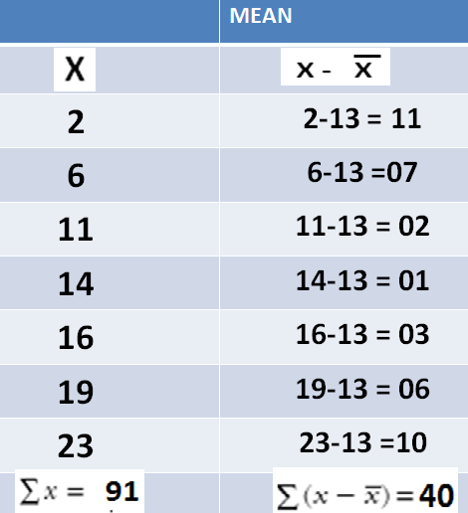


Find out mean deviation from MEAN and MEDIAN
X = 2, 6, 11, 14, 16, 19, 23
Formula: from Mean

Slide 47
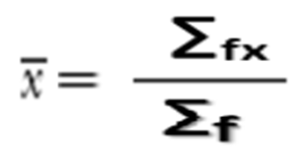
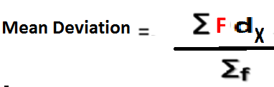
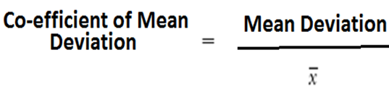
DISCRETE SERIES
Formula: from Mean

Slide 48





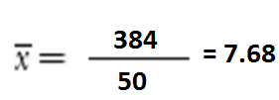
mean
x | f | fx
4 | 06 | 24 | 3.68 | 22.08
6 | 14 | 84 | 1.68 | 23.52
8 | 16 | 128 | 0.32 | 5.12
10 | 10 | 100 | 2.32 | 23.20
12 | 04 | 48 | 4.32 | 17.29

Slide 49



Slide 50
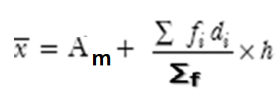
CONTINUOUS SERIES
Mean

Slide 51
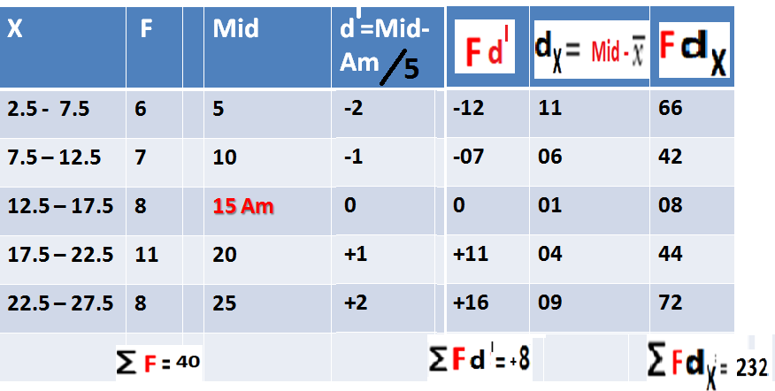
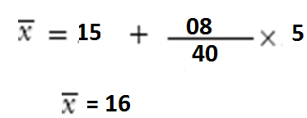
Mean

Slide 52
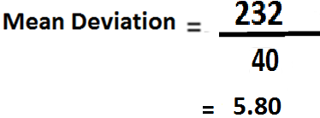

Mean

Slide 53
STANDARD DEVIATION
The numerical value of population or a sample variance is difficult to interpret because it is expressed in square units.
To reach a interpretable measure of variance expressed in the units of original data, we take a positive square root of the variance, which is known as the standard deviation or root-mean square deviation.
The standard deviation of population and sample is denoted by σ and s, respectively. We can think of the standard deviation as roughly the average distance values fall from the mean.

Slide 54
What is 'Variance'
Variance is a measurement of the spread between numbers in a data set.
The variance measures how far each number in the set is from the mean.
Variance is calculated by taking the differences between each number in the set and the mean, squaring the differences (to make them positive) and dividing the sum of the squares by the number of values in the set.

Slide 55

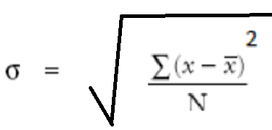
Standard deviation is a measure of the dispersion of a set of data from its mean.
Standard deviation is calculated as the square root of variance by determining the variation between each data point relative to the mean.
Standard deviation is an absolute measure of variation and expresses variation in the same unit of measurement as the arithmetic mean or the original data.

Slide 56
Coefficient of variation:
The coefficient of variation is a measure of spread that describes the amount of variability relative to the mean.
A measure of relative variability computed by dividing the standard deviation by the mean, then multiplying by 100.

Slide 57
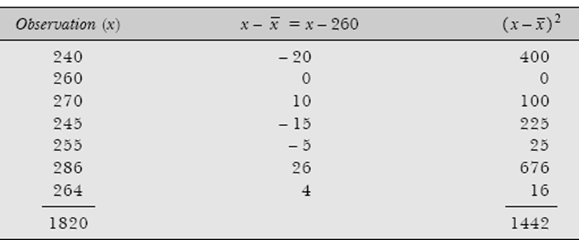
EX: The wholesale prices of a commodity for seven consecutive days in a month is as follows: Calculate the variance and standard deviation and coefficient of variation
Soln: Computations of Variance and Standard Deviation by Actual Mean Method

Slide 58
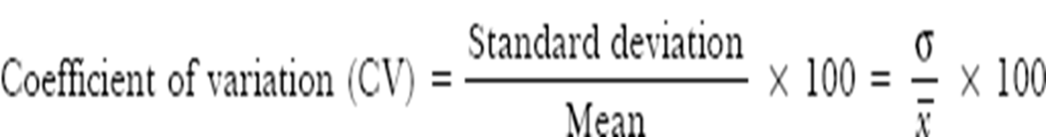
Cv = (14.352 / 260) x 100 = 5.52

Slide 59
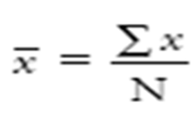
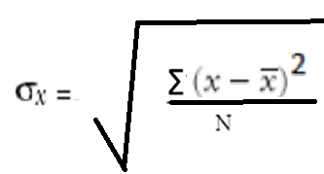
INDIVIDUAL SERIES direct method ungrouped data

Slide 60



INDIVIDUAL SERIES direct method ungrouped data
Find SD and Co-efficient of variance of:
130 137 136 142 135
X | X - X̄ | x²
130 | -6 | 36
137 | +1 | 1
136 | 0 | 0
142 | +6 | 36
135 | -1 | 1
∑_{X} = 680 |  | 74
X̄ = 680 / 5 = 136

Slide 61

INDIVIDUAL SERIES short cut Method ungrouped data

Slide 62



INDIVIDUAL SERIES short cut Method ungrouped data
X | d = X - A | d²
130 | -6 | 36
137 | +1 | 1
A →136 | 0 | 0
142 | +6 | 36
135 | -1 | 1
∑_{X} = 680 | ∑d = 0 | ∑_{d}² = 74

Slide 63


DISCRIET SERIES direct method ungrouped data
Find out SD regarding daily sales of cooker in a shop

Slide 64



SOLN.

Slide 65


Slide 66

DISCRIET SERIES short cut method

Slide 67
DISCRIET SERIES short cut method ungrouped data
x | f | d= x - A | f.d | d² | f. d²
12 | 01 | -3 | -03 | 9 | 9
13 | 00 | -2 | -00 | 4 | 0
14 | 04 | -1 | -04 | 1 | 4
A →15 | 12 | 0 | 00 | 00 | 0
16 | 20 | +1 | +20 | 1 | 20
17 | 15 | +2 | +30 | 4 | 60
18 | 06 | +3 | +18 | 9 | 54
19 | 02 | +4 | +08 | 16 | 32
124 | ∑_{f} = 60 |  | ∑_{f.d} = 69 |  | ∑_{f.d}² = 179

Slide 68



Slide 69


CONTINUOUS SERIES GROUPED DATA

Slide 70
CONTINUOUS SERIES
x | f | mi | d = mi – A / 2 | f.d | d² | f. d²
78-80 | 03 | 79 | -02 | -06 | 4 | 12
80-82 | 15 | 81 | -01 | -15 | 1 | 15
82-84 | 26 | A →83 | 00 | 00 | 0 | 00
84-86 | 23 | 85 | +01 | +23 | 1 | 23
86-88 | 09 | 87 | +02 | +18 | 4 | 36
88-90 | 04 | 89 | +03 | +12 | 9 | 36
 | ∑_{f} = 80 |  |  | ∑_{f.d} = +32 |  | ∑_{f.d}² = 122

Slide 71



Slide 72
EX: From the prices of shares of X and Y, Find out which is more stable in value?
x | y
35 | 108
54 | 107
52 | 105
53 | 105
56 | 106
58 | 107
52 | 104
50 | 103
51 | 104
49 | 101

Slide 73

Soln:
x | X= X - X̄ | x² | y | Y = y-Ȳ | y²
35 | -16 | 256 | 108 | +3 | 9
54 | +3 | 9 | 107 | +2 | 4
52 | +1 | 1 | 105 | 0 | 0
53 | +2 | 4 | 105 | 0 | 0
56 | +5 | 25 | 106 | +1 | 1
58 | +7 | 49 | 107 | +2 | 4
52 | +1 | 1 | 104 | -1 | 1
50 | -1 | 1 | 103 | -2 | 4
51 | 0 | 0 | 104 | -1 | 4
49 | -2 | 4 | 101 | -4 | 16
∑x= 510 | ∑x = 0 | ∑x² = 350 | ∑y= 1050 | ∑y = 0 | ∑y² = 40

Slide 74










Slide 75




Slide 76
A sample of 50 cars each of 2 makes X and Y is taken and average running life is recorded.
a) Which of these two makes gives higher average life
b) Which of these makes has shown greater consistent performance? Use SD
LIFE (NO. OF YEARS) | MAKE X | MAKE Y
0 - 5 | 8 | 6
5 - 10 | 12 | 10
10 - 15 | 17 | 20
15 - 20 | 10 | 12
20 - 25 | 3 | 2

Slide 77

MAKE X |  |  |  | MAKE Y
LIFE (NO. OF YEARS) | MAKE X f | mi | Fi mi | MAKE Y f | mi | Fi mi
0 - 5 | 8 | 2.5 | 20 | 6 | 2.5 | 15
5 - 10 | 12 | 7.5 | 90 | 10 | 7.5 | 75
10 - 15 | 17 | 12.5 | 212.5 | 20 | 12.5 | 250
15 - 20 | 10 | 17.5 | 175 | 12 | 17.5 | 210
20 - 25 | 3 | 22.5 | 67.5 | 2 | 22.5 | 45
 | ∑_{f} = 50 |  | ∑_{fi.mi} = 565 | ∑_{f} = 50 |  | ∑_{fi.mi} = 595
Part ‘a’ Soln: = 565 / 50 = 11.3 yrs. life → make x
= 595 / 50 = 11.9 yrs. Life → make y (gives higher avg. life)

Slide 78
Make x
LIFE (NO. OF YEARS) | mi | d = mi – 12.5 / 5 | d² | MAKE X f | MAKE X F.d | MAKE X F. d²
0 - 5 | 2.5 | -2 | 4 | 8 | -16 | 32
5 - 10 | 7.5 | -1 | 1 | 12 | -12 | 12
10 - 15 | A →12.5 | 0 | 0 | 17 | 0 | 0
15 - 20 | 17.5 | +1 | 1 | 10 | 10 | 10
20 - 25 | 22.5 | +2 | 4 | 3 | 6 | 12
 |  |  | 10 | 50 | -12 | 66
Make x : SD = 5.62

Slide 79


Soln:

Slide 80
Make y
LIFE (NO. OF YEARS) | mi | di = mi – 12.5 / 5 | di² | MAKE fi | MAKE fi.di | MAKE fi. di²
0 - 5 | 2.5 | -2 | 4 | 6 | -12 | 24
5 - 10 | 7.5 | -1 | 1 | 10 | -10 | 10
10 - 15 | A →12.5 | 0 | 0 | 20 | 0 | 0
15 - 20 | 17.5 | +1 | 1 | 12 | 12 | 12
20 - 25 | 22.5 | +2 | 4 | 2 | 4 | 08
 |  |  | 10 | 50 | -6 | 54
MAKE Y: SD = 5.16
Therefore MAKE Y is having greater consistent performance

Slide 81


